Slide 1
Matplotlib: Bar Graph
Cayla Burch
CTEC 298
Dr. Bemley

Slide 2
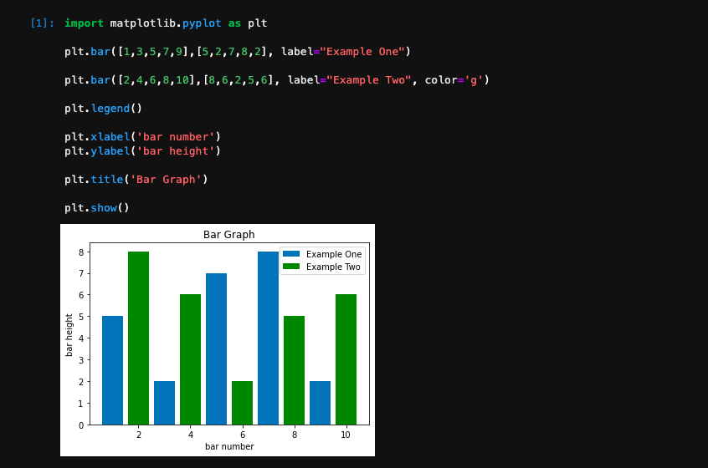
Bar Example using matplotlib

Slide 3
Why bar graphs are useful and when to use them
Comparing data between different groups (categorical)
To track large changes overtime
Ex: how many people watch different movie genres, how many people like different fruits, or how many much snow have we gotten each year

